Slide 1


Application-Specific Reconfiguration of RISC-V BOOM Core
ECE5504 Computer Architecture
Team Members:
Rutvik Ajit Jere
Punitha Kamasani
Vinodh Kumar

Slide 2
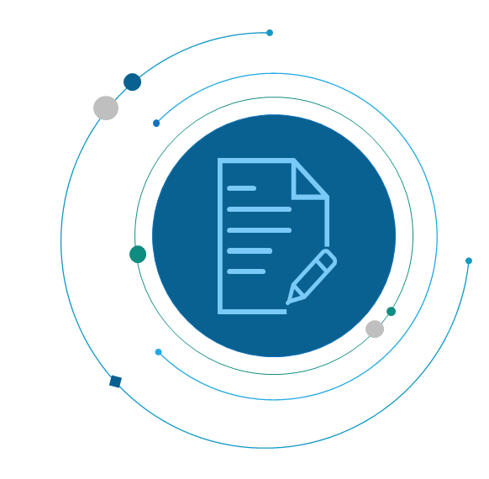
AGENDA
Background & Motivation
Applications studied
Proposed Method / Changes
Design Goals
Preliminary Results & Evaluation
Conclusion and Future Work

Slide 3
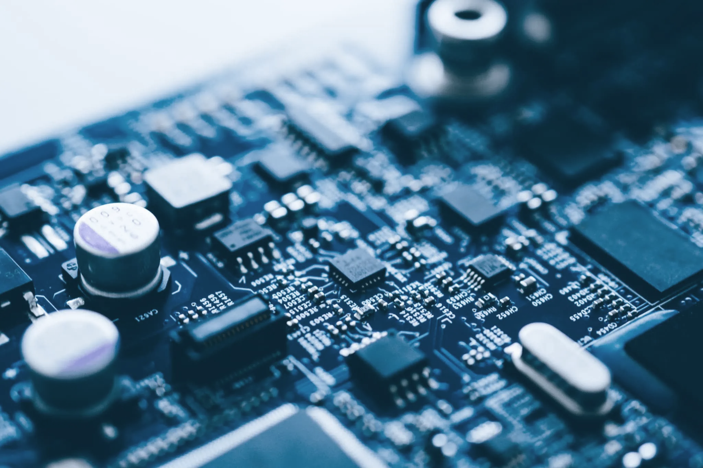
Background & Motivation
Modern applications require tailored hardware for peak efficiency.
RISC-V BOOM core offers reconfigurability to meet specific workload demands.
Exploring architectural optimizations for enhancing performance in specific applications.
Evaluate improvements using metrics like CPI and misprediction rate.

Slide 4
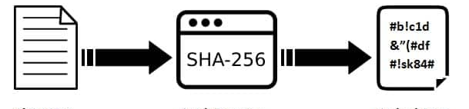
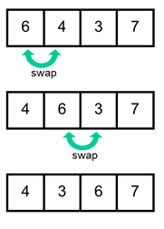
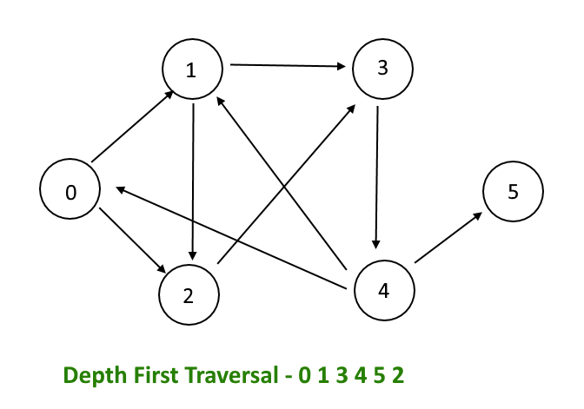
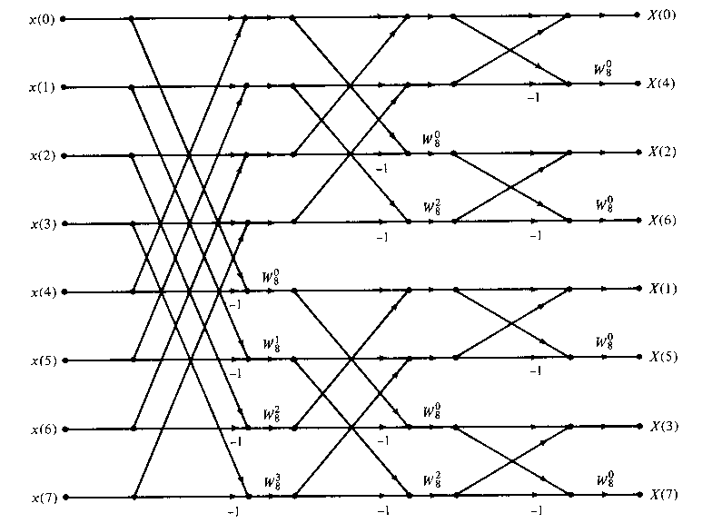
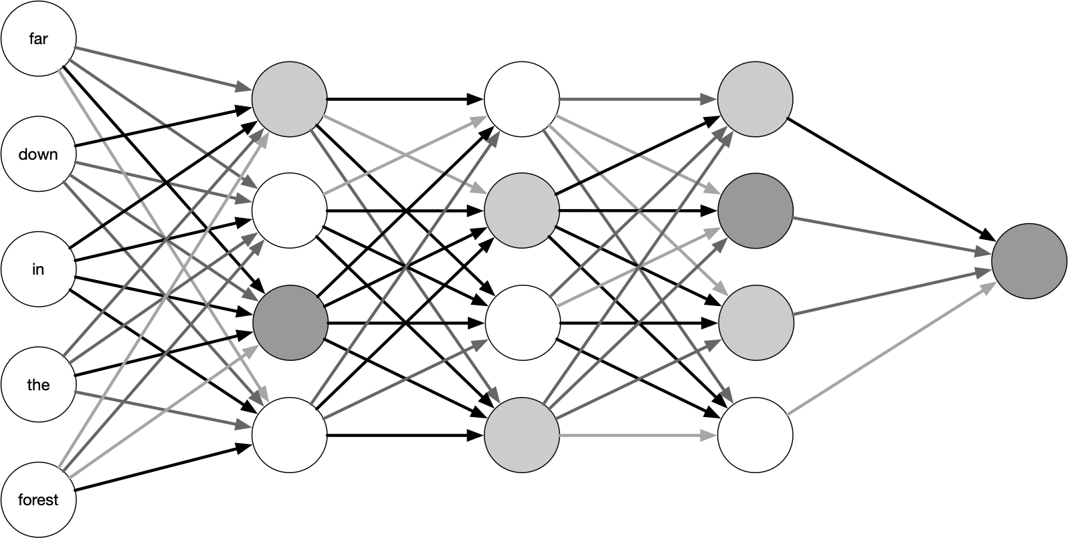
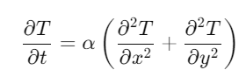
Applications Studied
Compute-Intensive Applications
Machine Learning (DNN)
Fast Fourier Transform
Finite Difference Method (Heat Equation Solver)
Algorithm-Based Applications
Graph Traversal (DFS)
Data Encryption (SHA-256)
Sorting Algorithms (Bubble Sort)

Slide 5
Application 1: Machine Learning
Benchmark: Custom DNN program.
Observations and Optimizations:
The application utilizes floating point values, matrix multiplication and loops to train a neural network.
Floating point values: Increase physical floating-point registers and decrease the latency for SMAFPUs and DMAFPUs.​
Loops: Implement TAGE-L Branch Predictor Design to anticipate moving back up the loop and implement cache optimization (LRU Replacement Policy). Accommodate the large vectors and the frequently used vectors.
Performance metric: Cycles per Instructions (CPI).
**SMAFPU – Single Precision Multiply Accumulate FPUs
DMAFPU – Double Precision Multiply Accumulate FPUs

Slide 6
Preliminary Results & Evaluation
Config | CPI
Baseline | 2.060
Optimized | 1.049
Speedup | x1.964
Modification | Impact
BPD | Approximately 50%
Cache Optimization | Approximately 40%
Floating Point based | Approximately 10%

Slide 7
Application 2: Graph Traversal
Benchmark: Custom Depth First Search program.
Observations and Optimizations:
The application utilizes loops and recursive functions.
Branch prediction to anticipate to optimize stack navigation for recursive function calls and loops.
Possible BPDs:
TAGE-L BPD
Double BPD
Tourney (Alpha 2126) BPD
Shootout between the branch predictors to reduce the branch mispredictions.
Performance metric: Branch Misprediction rate.

Slide 8
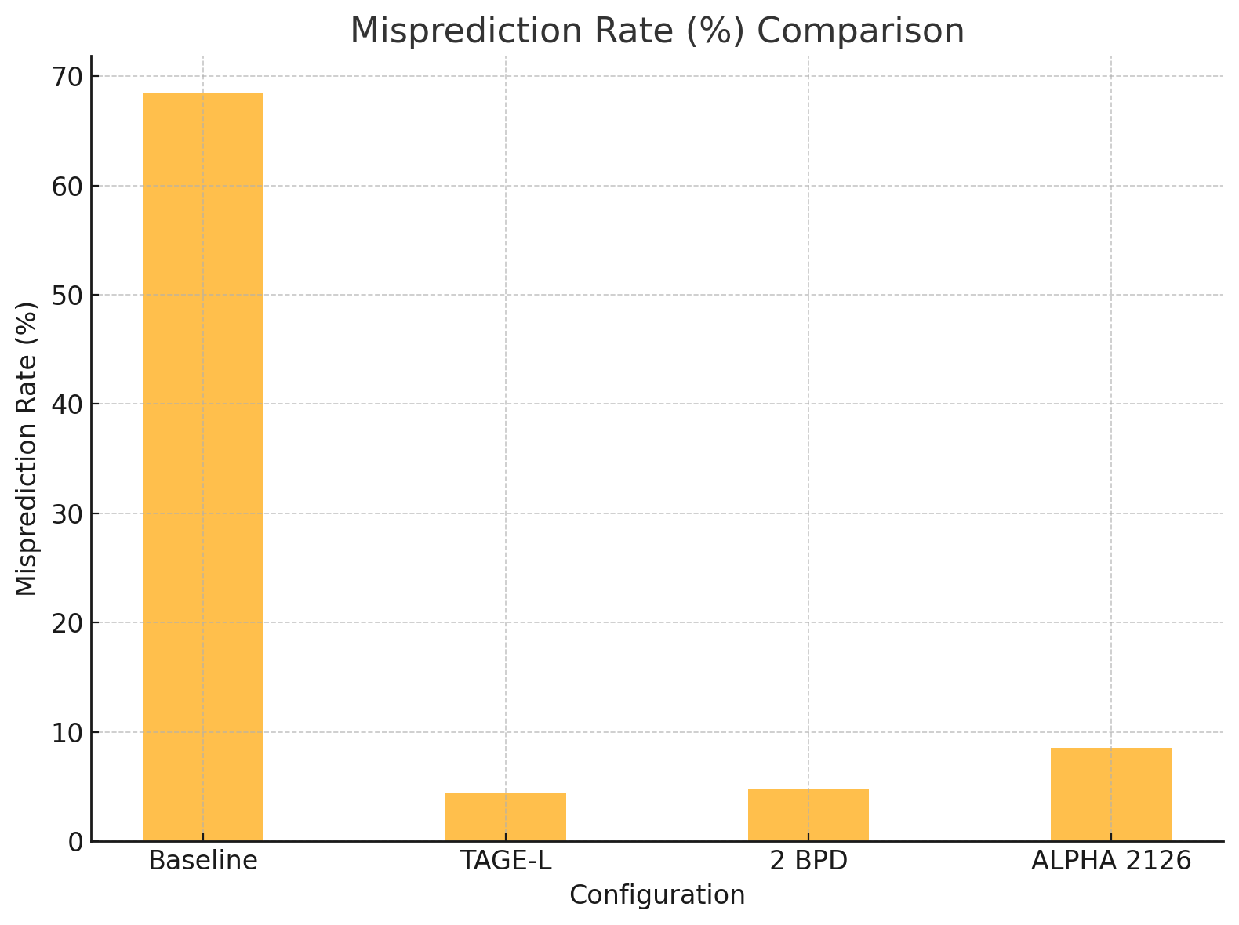
Preliminary Results & Evaluation
Config | CPI | Misprediction rate
Baseline | 2.938 | 68.48%
TAGE-L | 1.398 | 4.43%
2 BPD | 1.413 | 4.72%
ALPHA 2126 | 1.607 | 8.58%
By implementing the TAGE-L BPD, the speed up is x2.102 and the mispredictions decrease by 91.81% when compared to the baseline.

Slide 9
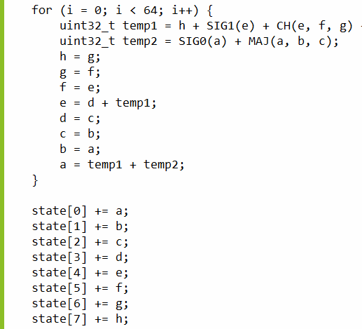
Application 3: Data Encryption (SHA-256)
Benchmark: Custom SHA 256 encryption program.
Observations and Optimizations:
The application relies heavily on bitwise operations (AND, OR, XOR) and modular arithmetic in a loop.
The encryption segment of the loops can utilize Instruction-Level Parallelism. This can be achieved by increasing the number of loads/store entries, decode width, integer issue width, fetch width etc. And reduce the floating-point physical registers.
Incorporated the L1 cache prefetcher to anticipate accessing the address of the hashing functions.
Performance metric: Cycles per Instructions (CPI)

Slide 10
Preliminary Results & Evaluation
Metric | Baseline | Optimized | % Change
Cycles | 41041 | 30453 | -25.82%
Instructions Retired (instret) | 30838 | 30898 | +0.19%
Instruction Cache Misses (I$ miss) | 100 | 99 | -1.0%
Data Cache Misses (D$ regular miss) | 46 | 53 | +15.22%

Slide 11
Application 4: Fast Fourier Transform
Benchmark: Custom FFT program with various input sizes.
Observations and Optimizations:
The application utilizes math/trignometry functions, vectors and loops to calculate the fourier transform.
Loops: Implement TAGE-L BPD (Branch Predictor) and implement cache optimization to loop mobility and access the address of the math functions.
Floating point values: Increase physical floating-point registers and decrease the latency for SMAFPUs and DMAFPUs for the trigonometric functions.
Performance metric: Cycles per Instructions (CPI) and D-cache miss.
**SMAFPU – Single Precision Multiply Accumulate FPUs
DMAFPU – Double Precision Multiply Accumulate FPUs

Slide 12
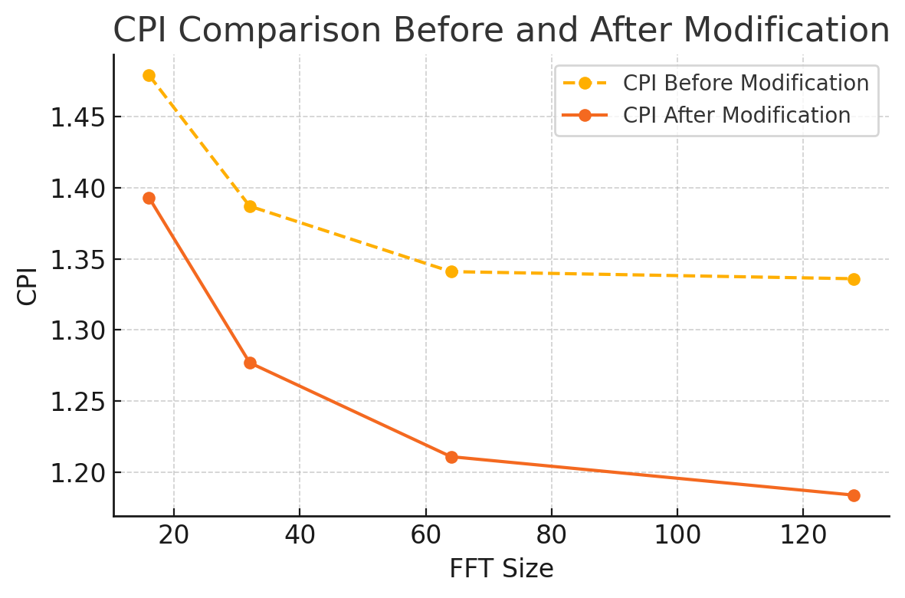
Preliminary Results & Evaluation
FFT Size | Metric | Before Modification | After Modification | Observations
16 | CPI | 1.479 | 1.393 | -5.8%
 | D$ Regular Miss | 15 | 15 | No change
32 | CPI | 1.387 | 1.277 | -7.9%
 | D$ Regular Miss | 24 | 24 | No change
64 | CPI | 1.341 | 1.211 | -9.7%
 | D$ Regular Miss | 45 | 43 | -4.4%
128 | CPI | 1.336 | 1.184 | -11.4%
 | D$ Regular Miss | 111 | 83 | -25.20%

Slide 13
Conclusion and Future Work
Many working accelerators exist within the chipyard directory.
Accelerators are designed to work with the rocket core or the large boom config.
We could use the Hwacha vector accelerator to optimize the BOOM config for ML and FFT based applications.
The SHA accelerator could be used to optimize the BOOM config for the SHA application.
For example, we noticed a CPI of 0.732 when we ran the DNN program on the default hwacha accelerator with the large boom config. Speedup of x2.814.

Slide 14

THANK YOU

